Slide 1
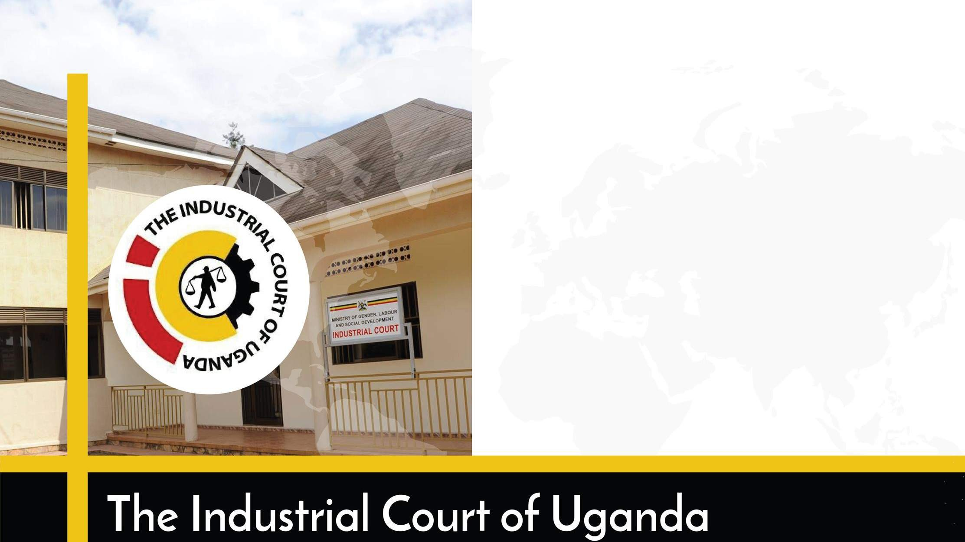
Procedural and Substantive Fairness
Presented by: A.Wabwire Musana
Ag. Judge.

Slide 2
The Applicable Law
The Employment Act, 2006
Formal procedures for discipline and termination
Establishment of the Industrial Court.

Slide 3
Procedural Fairness
The right to be heard.
The process of dismissal
Performance-related disciplinary processes
Misconduct-related disciplinary processes

Slide 4
Substantive Fairness
Substantive Fairness
Is there a reason?
Is there proof of misconduct?
Does the rule exist?
Is the reason for dismissal justifiable?

Slide 5
Challenges and effects of failure to adhere
Legal action
Increased conflict and tension
Loss of trust
Discrimination
Reputational damage
Regulatory challenges
Low employee morale and job satisfaction
High labour turnover

Slide 6
Best Practices
Clear policies
Regular training
Equal pay
Conflict resolution
Performance management
Employee Involvement
Work life balance
Anti harassment policy
Health and safety compliance
Anti harassment policy
Legal compliance reviews
Continuous improvement

Slide 7
Thank you for listening

Slide 8
Thank you for listening.

